Slide 1

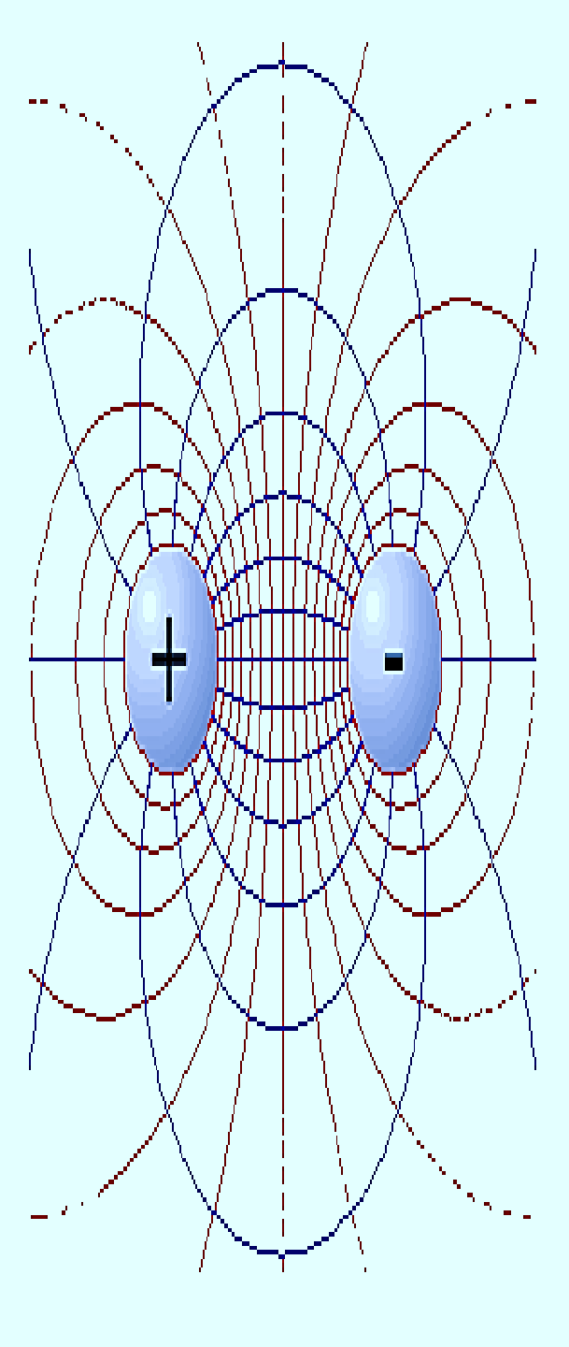





PRESENTATION ON:
COULOMB’S LAW
PREPARED BY:
PRAJAPATI ANKIT

Slide 2
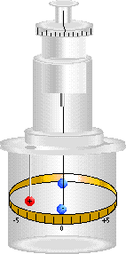
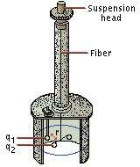
In 1785, The French Physician Charles Augustine De coulomb Published His First Three Reports Of Electricity And Magnetism Where He Stated His Law.
Development Of The Theory Of Electromagnetism
He used a Torsion Balance to study the repulsion and attraction forces of charged particles.
This dial allows you to adjust and measure the torque in the fibre
This scale allows you to read the separation of the charges
Fig. Torsion Balance

Slide 3
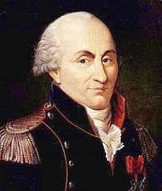
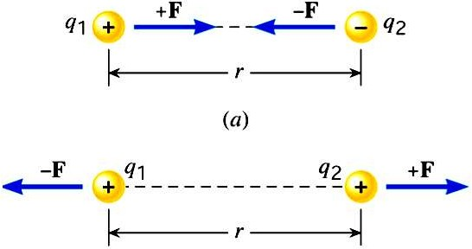
C OULOMB’S LAW STATEMENT
Between Two Point Charges There Is Force Of Attraction Or Repulsion Depending Upon the Nature Of Charges.
Charles Augustine de Coulomb
Fig. Understanding Of Attraction And Repulsion

Slide 4

1)F Q1Q2
Coulomb Showed That:
1
2)F
_{R}2
3)The Magnitude Of the Force Depends on the Medium.
By Combining Two Equations We Get,
Q1Q2
F
_{R}2
Using Proportionality K We Get,

Slide 5


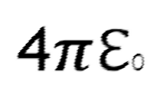



N
The Constant Of Proportionality Is Given By:
K = ¹
ℇ0 = 8.84
12 _{C} 2 _{/ Nm} 2
10
Then the Force is Given by following equation:
1
Q Q
F
1 2
_{R} 2
N
4
0
LIMITATIONS
The charges to be considered are Point Charge.
They Should Be Stationary With Each Other.

Slide 6
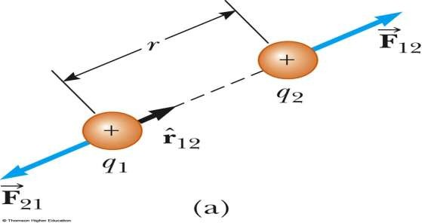
COULOMB’S LAW IN VECTOR FORM
Force on Q1 is given by
Force on Q2 is given by
₁ Q Q
Q Q
1 2
R 12 ²
1
1 2
R 21 ²
^
r^
F12 =
r 21
F21 =
12
4
4
0
0
,We Can Write

Slide 7
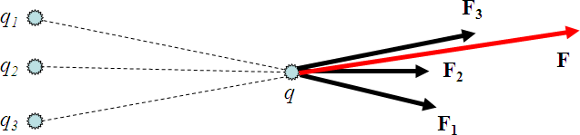
COULOMB’S LAW IN SUPERPOSITION FORM
Electric forces follow the law of superposition.
If more than one charge is causing a force on object 1, then the net force acting on object 1 is just the sum of all the individual forces acting on 1.
Fig. Superposition Law
Net force on q: F = F₁ + F₂ + F₃

Slide 8



















Slide 9

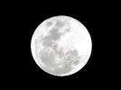
APPLICATIONS
To calculate Force(F) Or Distance(R) between two charges.
To calculate electric field
E is the electric field strength
F
_{E=} (N/C)
F is the electrostatic force
e
QT is the Test charge in coulombs
QT
To calculate Force on one point due to several
Points(Superposition Theorem)
DISADVANTAGE
We can’t apply Directly the Coulomb’s Law Calculate Charge on Big planets

